Slide 1

TOPIC 2: THE ANALYSIS AND DESIGN OF WORK

Slide 2

1. Job analysis

Slide 3

Job analysis is a proper match between work and employee capabilities is now an economic necessity, and organizations that fail to have the right people in the right place at the right time are at risk.

Slide 4

The purpose of job analysis is to determine why jobs exist, what tasks are required within the job, when, where and how the job is performed, under what conditions, and what qualifications are needed to perform the job.

Slide 5

Job analysis provides information about three basic aspects of a job:
job content: the duties and responsibilities of work;

Slide 6

job requirements: the formal qualifications, knowledge, skills, abilities and personal characteristics which employees need to perform the content of the job

Slide 7

job context: situational and supporting information regarding the particular job.

Slide 8

There are two basic approaches to job analysis:
a job-oriented (or task) approach – is concerned with what gets done​
an employee-oriented (or behavior) approach focuses on how the job is done

Slide 9

Job analysis is generally undertaken when:
the organization commences and the job analysis program is started;
a new job is created;
a job is changed significantly as a result of new methods, new procedures or new technology.

Slide 10
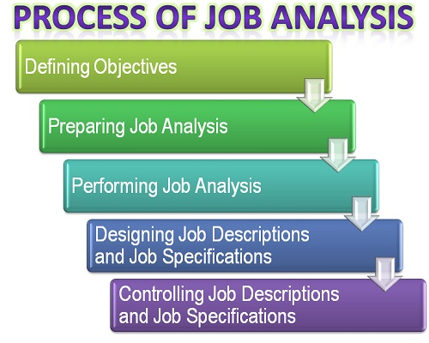

Slide 11
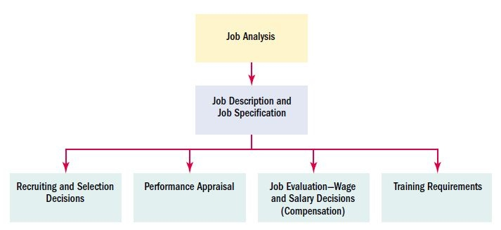

Slide 12

job descriptions – is a written statement explaining why a job exists, what the job-holder actually does, how he or she does it, and under what conditions the job is performed;

Slide 13

job specifications or person specification is derived from the job description. It identifies the experience, qualifications, skills, abilities and knowledge, personal qualities and special requirement needed ti successfully perform the job;

Slide 14

job design – job design identifies what work must be performed, how it will be performed, where it is to be performed and who will perform it.

Slide 15

organizational structure and design – job analysis by clarifying job requirements and the inter relationships among jobs means content and tasks duties and responsibilities at all levels can be specified, thus promoting efficiency by minimizing overlap or duplication.

Slide 16

HR or personnel planning involves getting the right number of qualified people into the right job at the right time.

Slide 17

recruitment – job analysis information helps the HR Manager attract better qualified candidates by identifying who to recruit and how and where to recruit them by establishing the job requirements that must meet.

Slide 18

selection – job analysis information identifies what the job is by defining what duties and responsibilities must be performed.

Slide 19

job orientation – a part of the orientation process in which a new employee is introduced to coworkers, and is given information such as working hours, place of work, performance standards, benefits and facilities, and names of the immediate and other officers;

Slide 20

performance standards and performance appraisal – deals with getting information about how well each employee is performing his or her job in order to reward those who are effective, improve the performance of those who are ineffective, or provide a written justification for why the poor performer should be disciplined.

Slide 21

training and development – it’s a function concerned with organizational activity aimed at bettering the job performance of individuals and groups in organizational settings.

Slide 22

career planning and development – entails matching an individual’s skills and aspirations with opportunities that are or may become available in the organization.

Slide 23

job evaluation – is a systematic way of determining the value/worth of a job in relation to other jobs in an organization.

Slide 24

compensation and benefits – focused on employee compensation and benefits policy-making.

Slide 25

healthy and safe working environment – the working environment should be both safe and stimulating, as well as a good example of collaboration and respect for the individuals.

Slide 26

industrial relations – is the study of the laws, conventions and institutions that regulate 'the workplace'.

Slide 27

METHODS OF JOB ANALYSIS
1.Functional Job Analysis (FJA) – uses standardized statements and terminology to describe the nature of jobs and to prepare job descriptions and job specifications.

Slide 28

2.Position Analysis Questionnaire (PAQ) – is a job analysis instrument and scoring/reporting service that is marketed commercially for quantitatively assessing jobs

Slide 29

3. Management Positions Descriptions Questionnaire (MPDQ) – is a behaviorally oriented, structured questionnaire for describing, comparing, classifying and evaluating management positions.

Slide 30

4. Position Classification Inventory (PCI) – is a job analysis inventory which can be used to classify occupations and to assess person–job fit

Slide 31

5. Hay Guide Chart Profile Method – job content is analyzed in terms of three major factors that are present to some degree in every job.

Slide 32

6. New multi-method approaches based on computer technology and sophisticated quantitative techniques are now coming into use.

Slide 33
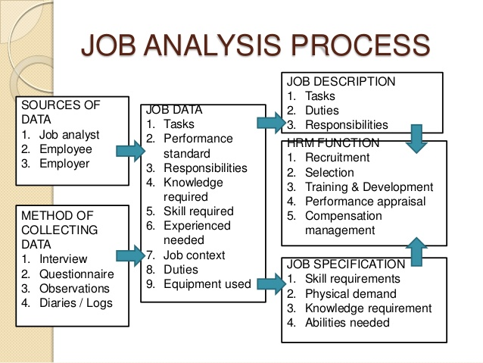

Slide 34
2.Job design

Slide 35

Job design is the specification of the content of a job, the material and equipment required to do the job, and the relation of the job to other jobs.

Slide 36
THEORIES OF JOB DESIGN
Classical theory
Behavioral theory
Situational theory

Slide 37
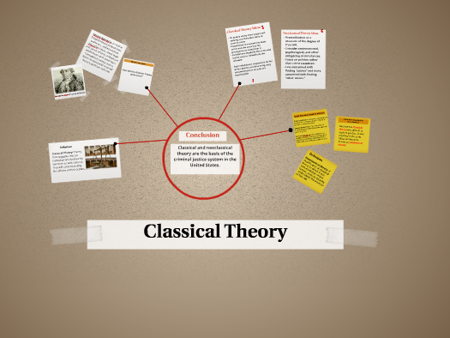
Classical theory
Was expounded in early writings of Max Weber and Henri Fayol. For the classicist, any organization achieves efficiency through its division of labor. Managers identify the overall purpose of the organization. They then divide this overall purpose into jobs, each rationally related to the whole. Jobs are, in turn, grouped to create work groups, divisions, and departments. Finally, each group is assigned a supervisor, who is responsible for overseeing the work of subordinates and reporting the results to his or her own superior.

Slide 38
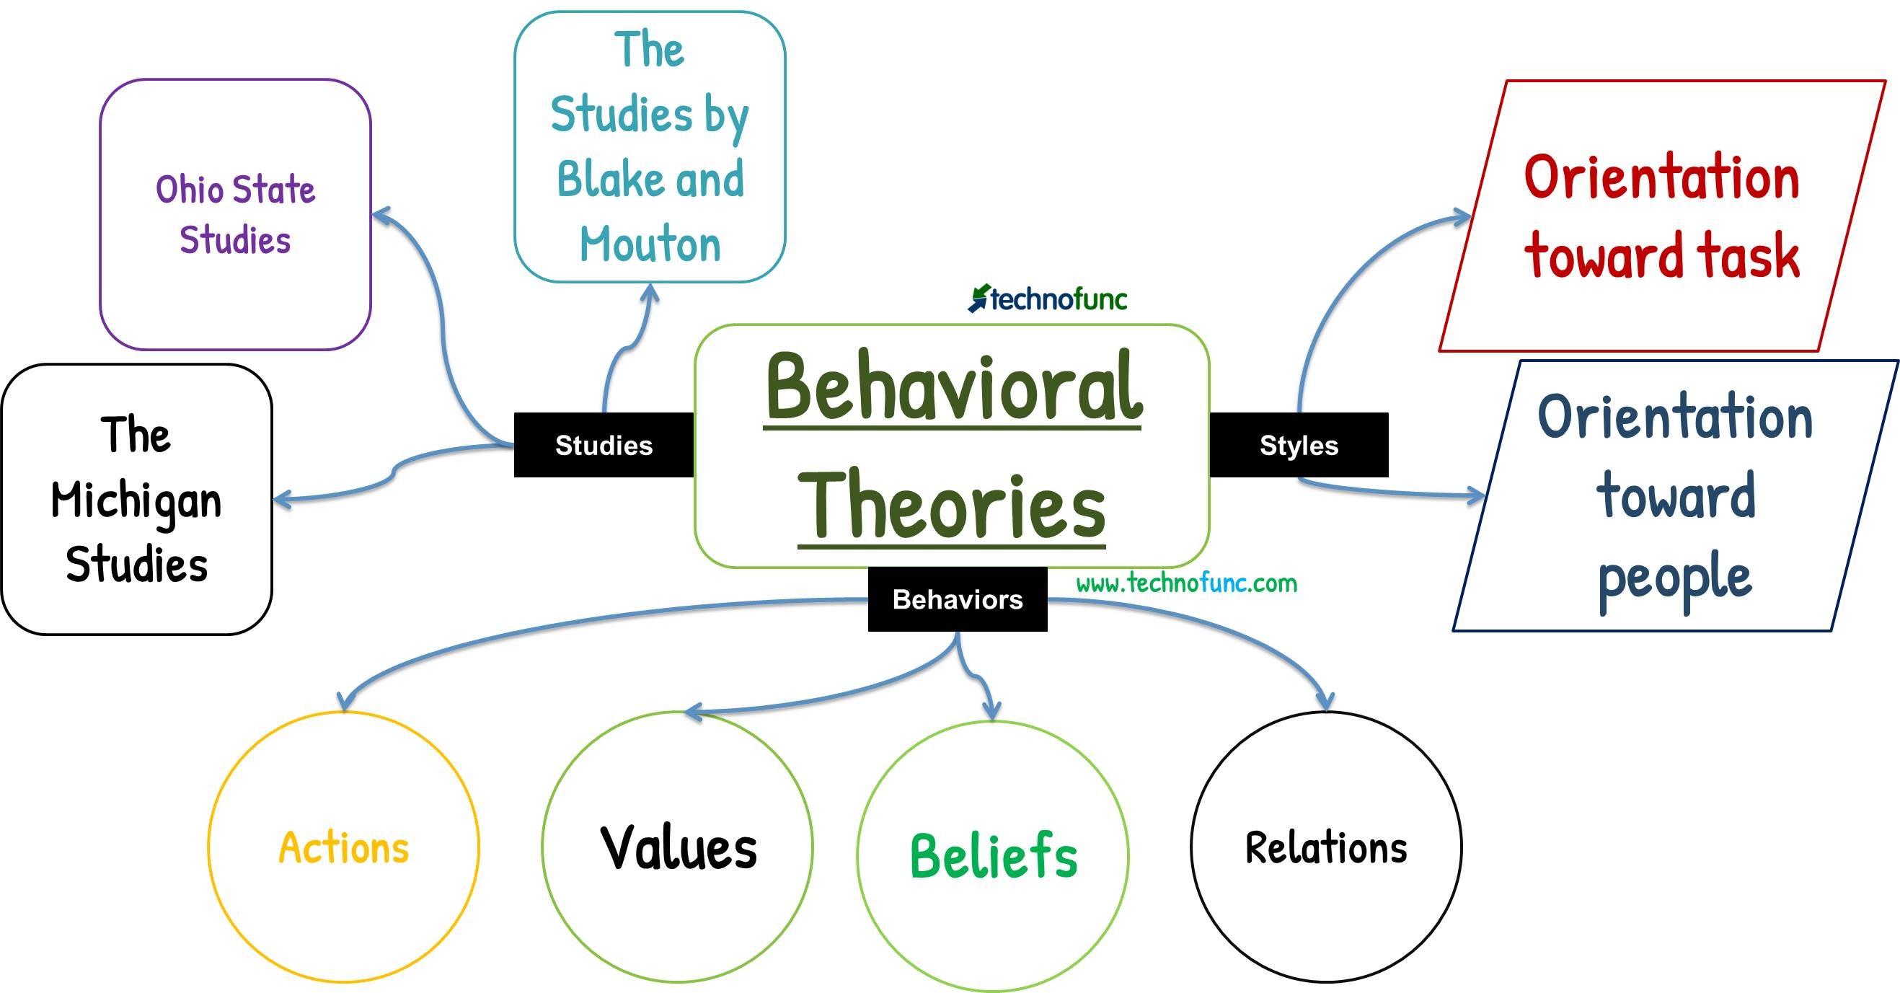
Behavioral theory
Unlike the classicist, the behavioralist is much less interested in allocating specific tasks to specific jobs, making sure that the authority matches the position, and then trying to attain higher efficiency through specialization of labor. Behavioralists prefer simple organizational structure, decentralized decision-making, and informal departmentalization. In an organic structure, subordinates feel free to discuss their performance problems with superiors and have a positive view of the organization. They participate in decision-making and communicate with those whose views are needed to solve immediate problems. These characteristics are in stark contrast to conditions in a traditional organization, where subordinates are guarded and negative about the organization, do not feel sufficient trust to communicate openly with those of higher status, and are not permitted to participate in decision-making.

Slide 39

Situational theory
Differs from both classical and behavioral theories. Advocates stress the influence of the external environment on the allocation of responsibilities and tasks within the organization, work groups, and jobs. Allocating responsibilities and tasks means creating a structure. Appropriate structures differ according to technology, markets, production, research, and information.

Slide 40

METHODS OF JOB DESIGN
Job specialization – involves using standardized work procedures and having employees perform repetitive, precisely defined and simplified tasks.

Slide 41

Job enlargement – seeks to horizontally load a job by adding to the variety of tasks to be performed.

Slide 42

Job rotation – increases task variety by periodically shifting employees between jobs involving different tasks.

Slide 43

Job enrichment – involves making basic changes in job content and level of responsibility.

Slide 44

Socio-technical enrichment – focuses on the relationship between technology and groups of workers.

Slide 45

Autonomous work teams – represent job enrichment at the group level. The employer sets up self-managed work teams who are responsible for accomplishing defined performance objectives.

Slide 46

AREAS OF JOB DESIGN
checking the work overload;
checking upon the work under load;
ensuring tasks are not repetitive in nature;
ensuring that employees don not remain isolated;
defining working hours clearly;
defining the work processes clearly.

Slide 47

BENEFITS OF A JOB DESIGN
1. Employee Input: A good job design enables a good job feedback. Employees have the option to vary tasks as per their personal and social needs, habits and circumstances in the workplace.

Slide 48

2. Employee Training: Training is an integral part of job design. Contrary to the philosophy of “leave them alone’ job design lays due emphasis on training people so that are well aware of what their job demands and how it is to be done.

Slide 49

3. Work / Rest Schedules: Job design offers good work and rest schedule by clearly defining the number of hours an individual has to spend in his/her job

Slide 50

4. Adjustments: A good job designs allows for adjustments for physically demanding jobs by minimizing the energy spent doing the job and by aligning the manpower requirements for the same.

Slide 51
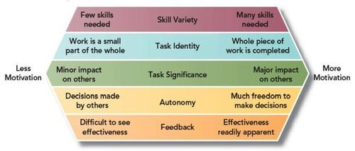
MOTIVATIONAL JOB DESIGN

Slide 52

Lection is over! Thank you for your attention!

